Slide 1

Psychological Disorders
Chapter 15

Slide 2
Announcements
Quiz 9 (due 11/8)
Research (go do the thing!) Due by 5:00pm 11/28!
  https://msutexas.edu/academics/libarts/psychology/undergraduate-research.php

Slide 3

Abnormal Psychology
Study of human behavior that is atypical of one’s culture and society
Clinical focus
  Rehabilitation of individuals to improve functioning and well being
    Clinical Psychology
    Counseling Psychology

Slide 4
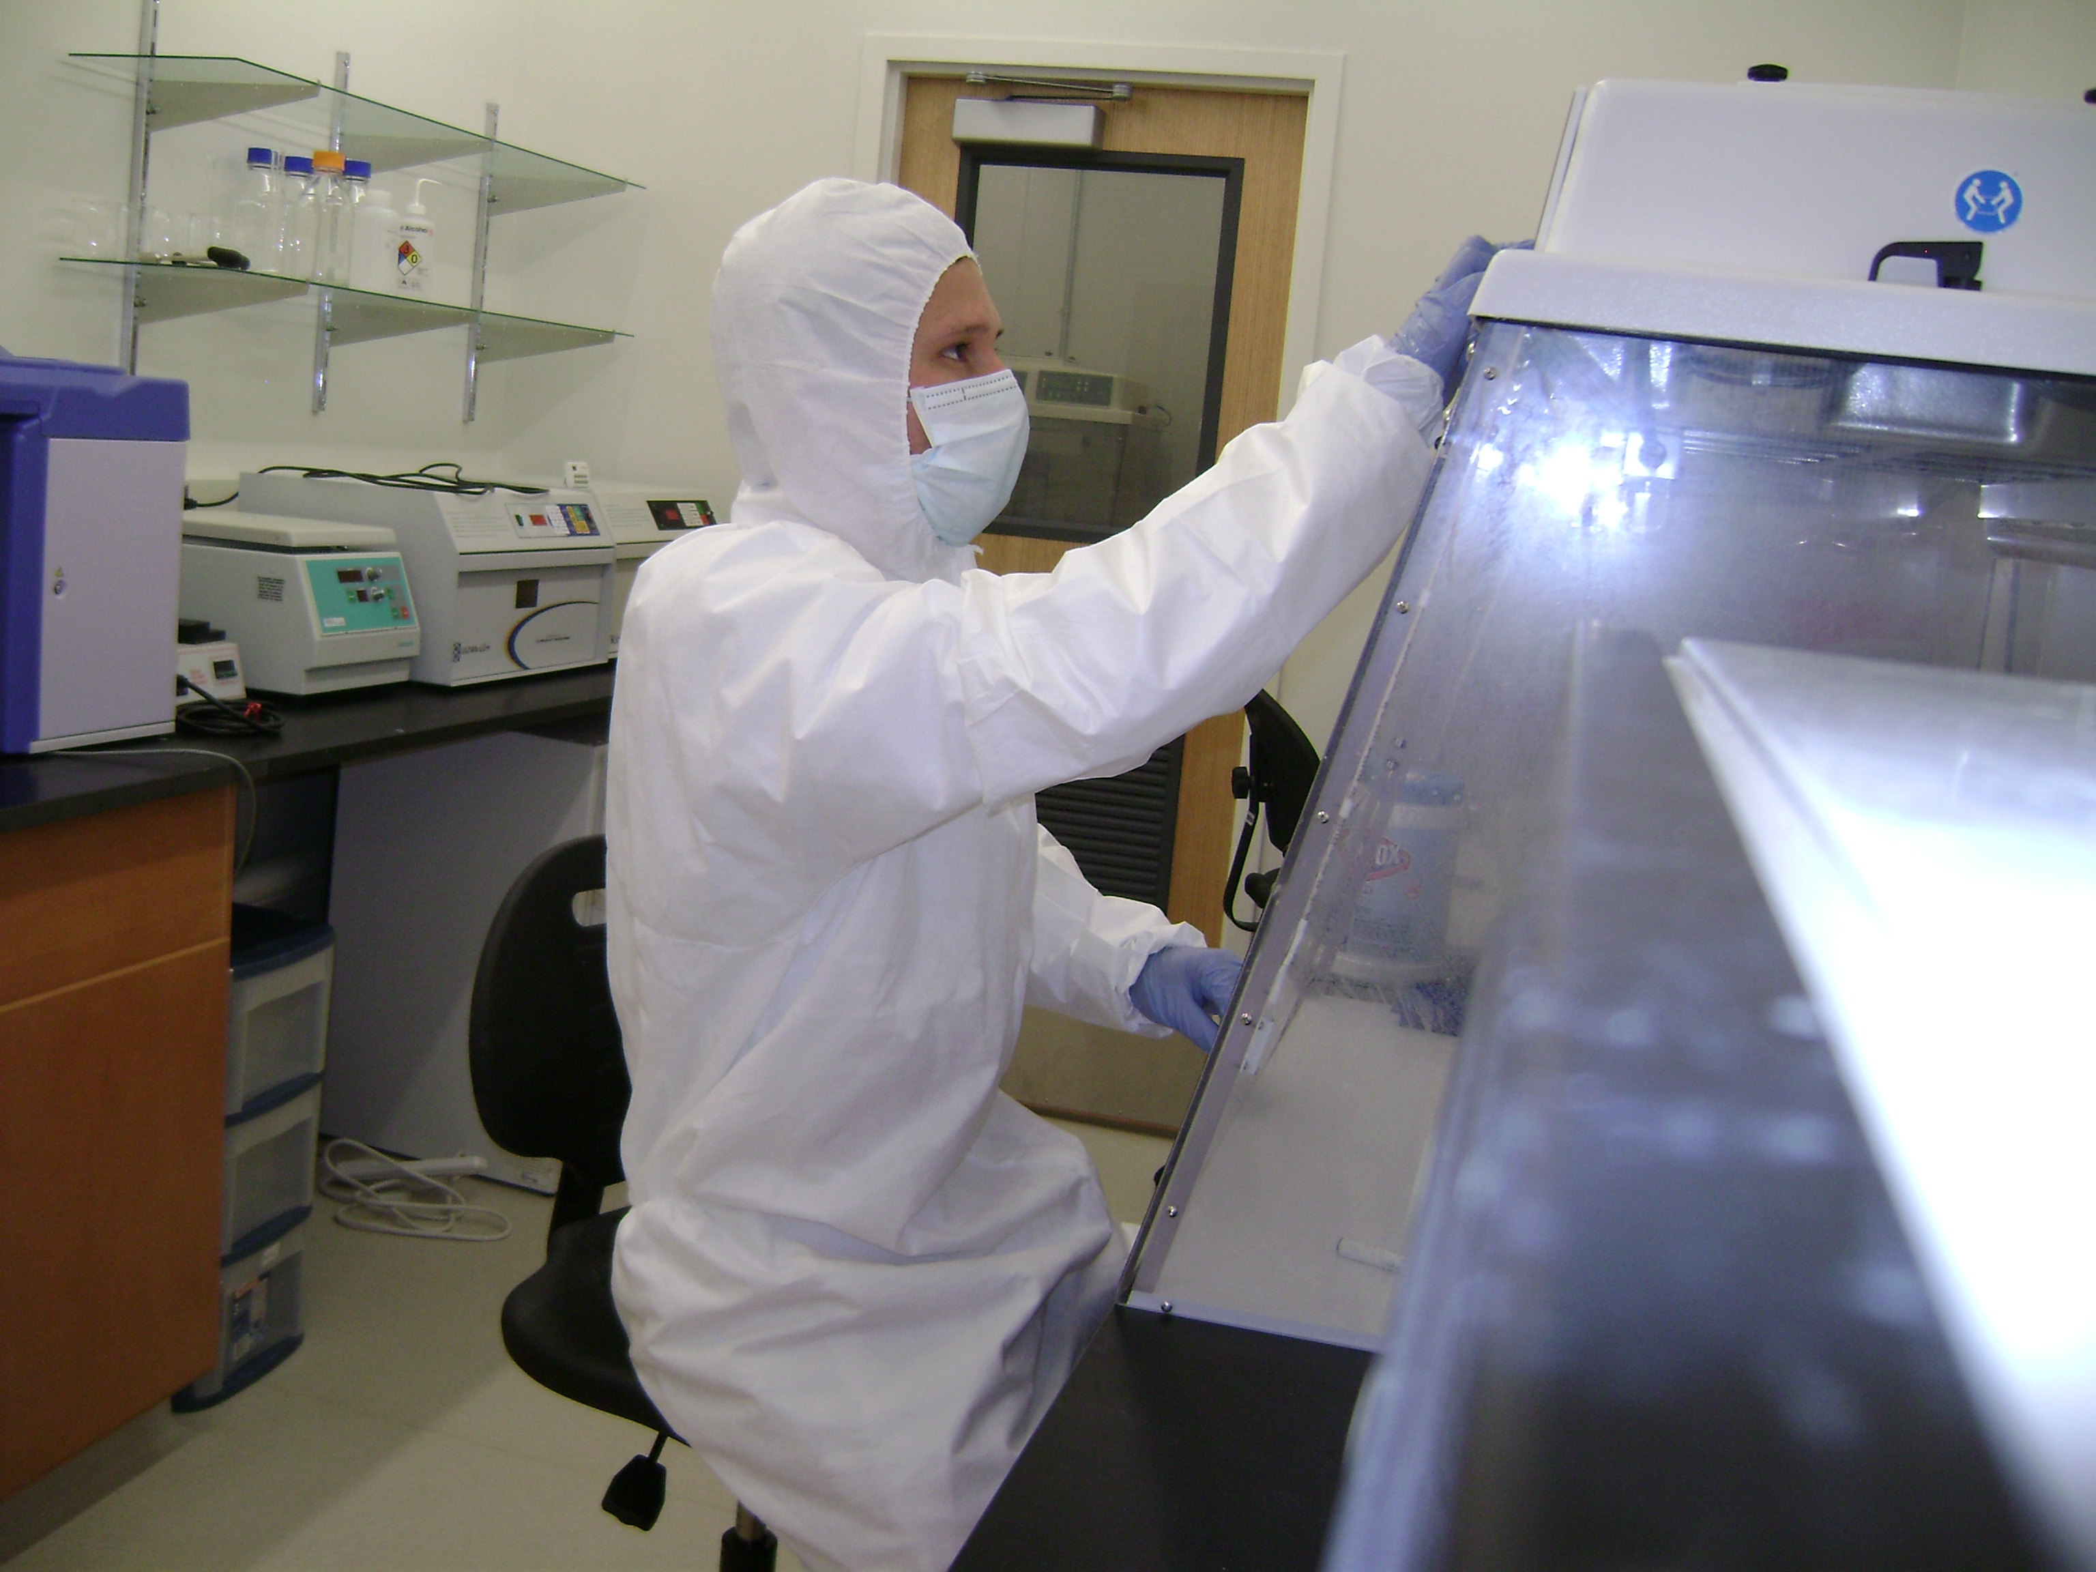

What is a psychological disorder?
Abnormal behavior: Deviant, maladaptive, or personally distressing over a long period of time

Slide 5
What is a psychological disorder?
Deviant: Violates social norms and expectations
Maladaptive: Interferes with a person’s ability to function effectively in daily life
Personally distressing: The person engaging in the behavior finds it unpleasant/wants to stop

Slide 6
What is a psychological disorder?
Social acceptability and the oppressive use of “disorder”
Drapetomania (a mental disorder in which slaves fled from slavery; Cartwright, 1851)
Homosexuality (until 1973)
Hysteria

Slide 7
What is a psychological disorder?
Where does disorder come from?
  1) Biological approach: A medical model that views psychological disorder as essentially the same as biological illness
  2) Psychological Approach: Sees experience, thought, emotion, and/or personality as causes of mental disorder

Slide 8
What is a psychological disorder?
Where does disorder come from?
  3) Sociocultural perspective: Because social norms define disorder, some disorders are the result of a cultural setting
  Example: Anorexia (almost exclusively occurs in Western cultures)

Slide 9
What is a psychological disorder?
Biopsychosocial model is used to understand the many factors contributing to psychological disorders

Slide 10
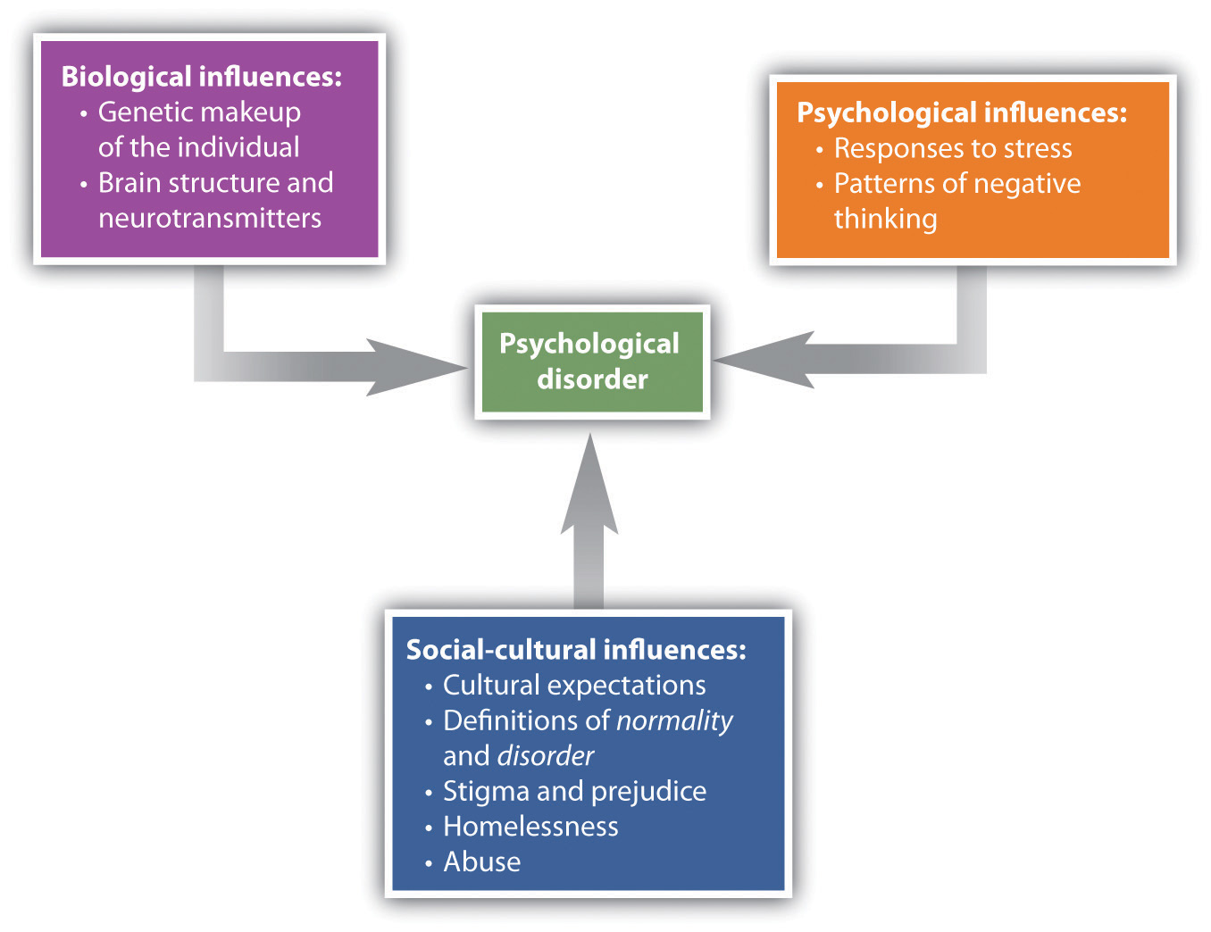

Slide 11
The “4 D’s” of Abnormality
Deviance
  Thoughts, behaviors, and/or emotions that are unacceptable in society
Distress
  Feeling despair
Dysfunction
  Impairment of an individual’s ability to perform daily function
Danger
  Behavior that could jeopardize safety or physical/psychological well being of others

Slide 12
The “4 D’s” of Abnormality
Must disrupt functioning of an individual on a daily basis
  Possess one or more of the Ds
So what do the 4 Ds tell us???
  The VAST majority of people (including you!) do not struggle with a psychological disorder!
  If you do, they can be treated!

Slide 13
First… Some Cautions
Gaining knowledge of psychological disorders…
  DOES NOT allow you to diagnose yourself with a psychological disorder
  DOES NOT allow you to diagnose/label others around you with a psychological disorder
  DOES NOT allow you to attempt to treat someone who does have a psychological disorder (i.e., play therapist)
  DOES allow you to gain some knowledge/perspective of the struggles of others
  DOES allow you to learn about the importance of mental health

Slide 14
Diathesis-Stress Model
Clinical psychologists use a diathesis-stress model of disorders
  Diathesis
    Underlying predisposition to a mental disorder
  Stress
    A trigger that could increase the probability of a mental disorder

Slide 15
Diathesis-Stress Model
Low
Vulnerability
Amount of Stress
High
Vulnerability
Amount of
Stressor
Time

Slide 16
Vulnerability-Stress Hypothesis
Everyone differs to their susceptibility to mental illness based on:
  Daily stressors
  Personality factors
  Environmental changes (e.g., family death, breakup, etc.)
  Physical health
  Age

Slide 17
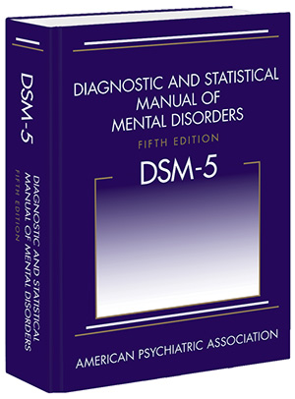
Classifying Abnormal Behavior
Classifying abnormal behavior: The Diagnostic and Statistical Manual (DSM)

Slide 18
Classifying Abnormal Behavior
The DSM is NOT the only classification system!
However, it is the primary manual used in the US
Current version: DSM-V (5)

Slide 19
DSM-V Classification System
Advantages
  Common definitions, agreed upon by clinicians
  Quantification of disorders
  Naming disorder provides comfort through knowledge of what symptoms/outcomes to expect
  Knowledge of how a disorder operates can lead to treatment
Disadvantages
  Naming can lead to stigma, labels (shame, negativity)
  Medical terminology implies internal cause (neglects experiential/psychological causes

Slide 20
Other Disadvantages of the DSM
1) Curated heavily by psychiatrists, who tend to use a biological model
2) Relies on vague or loose criteria

Slide 21
Neurodegenerative Disorders:
Autism Spectrum Disorder
Persistent deficits in social interaction and communication
Engagement in restrictive repetitive behaviors
Diagnosed in children, thought to produce lifelong impairment
  1:69 diagnosed
  Spectrum: Highly variable symptom severity
  More common in boys

Slide 22
Neurogenerative Disorders:
Attention-Deficit/Hyperactivity Disorder
Inattention, hyperactivity, impulsivity
  2/3rds persist to adulthood
  Medication (stimulants) and therapy are effective treatments
  Deficit of cognition/executive function
  Symptoms improve as children age
Very commonly diagnosed in children
  Over-diagnosed?
  Diagnoses increased 2000% from 1988 to 2010 (10.4 million diagnosed in 2010)
  Why?
  Is “normal” childhood behavior considered psychopathology?

Slide 23
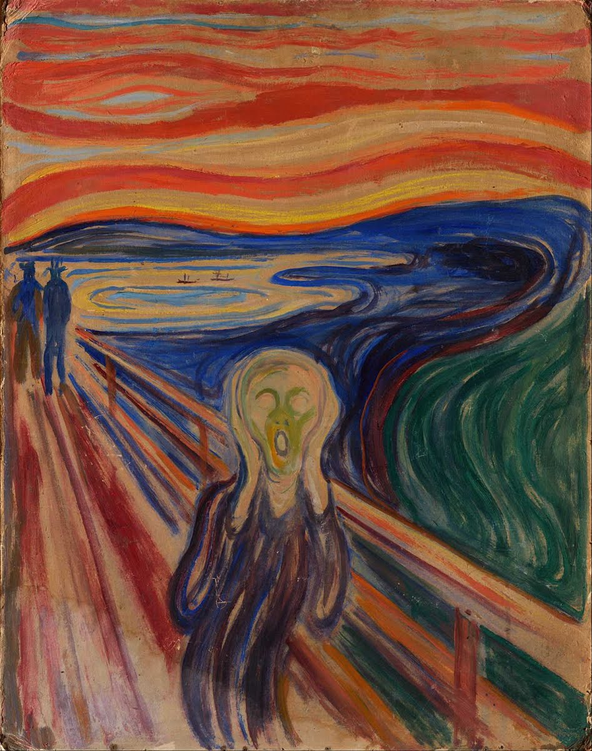
Anxiety/Anxiety-Related Disorders
Uncontrollable fears that are disproportionate and disruptive to daily functioning
Generalized Anxiety Disorder (GAD)
Panic Disorder
Specific Phobia
Social Anxiety Disorder
Anxiety-related disorders
  Obsessive-compulsive disorder
  Post-traumatic stress disorder

Slide 24
Generalized Anxiety Disorder (GAD)
Symptoms
  Persistent anxiety for at least 6 months
  Suffer: Fatigue, muscle tension, stomach problems, insomnia
Etiology (causes)
  Biological Factors
    Genetic factors, GABA deficiency, respiration
  Psychological/Sociocultural Factors
    Harsh self-standards, critical parents, constant negative thoughts, trauma

Slide 25
Generalized Anxiety Disorder (GAD)
Must also have detrimental effects on a person’s well-being
In GAD, there is no one specific problem that is the focus of anxiety
GAD has high comorbidity with depression, so anti-depressants are a common treatment)

Slide 26
What Causes GAD?
1) Cognitive explanation: Worry about a target (e.g., money) is compounded with worrying ABOUT worrying (Wells, 1995)
2) Genetic explanation: GAD tends to run in families. Genetic factors can explain 37.9% of the prevalence of GAD (Scherrer et al., 2000)
3) Biological causes: Problems in the production of GABA, a primary inhibitory neurotransmitter (Boschen, 2012)

Slide 27
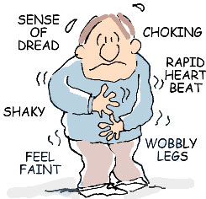
Panic Disorder
Symptoms
  Recurrent, sudden onset of intense terror that often occurs without warning
  NO SPECIFIC CAUSE
  Panic Attacks are persistent
Etiology
  Biological Factors
    Genetic Predisposition
    Norepinephrine, GABA, and Serotonin
    Hormone regulation in response to stress
  Psychological Factors
    Conditioning to CO₂: High levels mean stress/trauma
  Sociocultural Factors
    Women > Men

